Slide 1

Organ Donation Portal
Presented By :
Rucha Sachin Chauthai (002100149)
Gauri Narendra Bhale(002955836)
Archie Sanghavi (001531205)

Slide 2
Problem Statement
Organ Donation and transplantation is a medical procedure in which a donor’s organ is removed and placed into a receiver’s body.
Organ transplantation is done if the receiver has an organ failure due to damage, injury or illness.
Everyday approximately 20 patient die in the United States just being on ‘waitlist’ for organ.
This happens due to lack of donor as compared to the demand for it.

Slide 3
Solution
A good application can resolve the problems like death due to lack of donors, lack of awareness about organ donation, lack of communication links between doctors, receivers and donors which arise in organ donation management system.
These issues of an organ donation management system can be well handled by assigning appropriate roles and responsibilities to the elements of the system, and this is where our application plays a significant role.
The application that is developed by us would be able to address these problems to a great extent. In organ donation portal all the enterprises of the system would be working in sync to achieve the desired output.

Slide 4
Organ Donation Information
An organ can be donated by any person irrespective of gender or age.
A donor can be alive person or a deceased one.
For organ donation donor needs to provide his/her medical history.
As the requirement for organs are more than the current donors count people are enrolled to a ‘waitlist’, were receivers wait for their turn and appropriate match.
For organ donation procedure donor and receiver also need to consult law professionals to complete with legal formalities before medical procedures.
Organs like Heart, Kidney, Liver, Eyes and Bone marrow are the organs that are in high demand.
Other human organs that can be donated are pancreas, Lungs, Intestine, Middle Ears, Skin and Bone.

Slide 5
Approach
Request generation & pass between different enterprises and organization.
Maintaining work queue and work request.
Creating user accounts for organizations and roles.

Slide 6
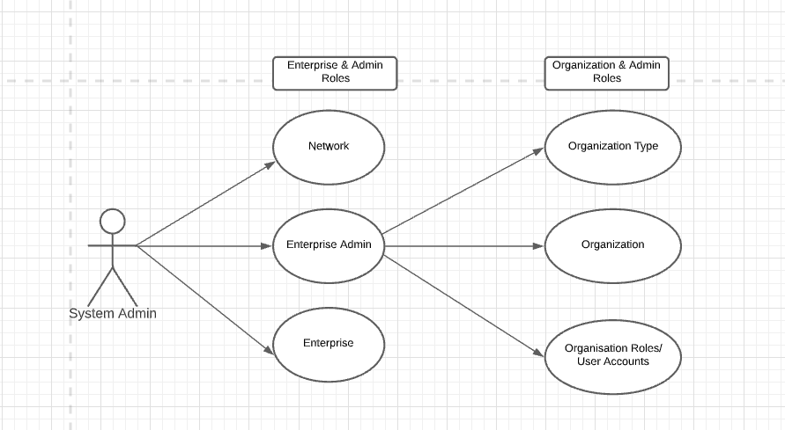

Slide 7
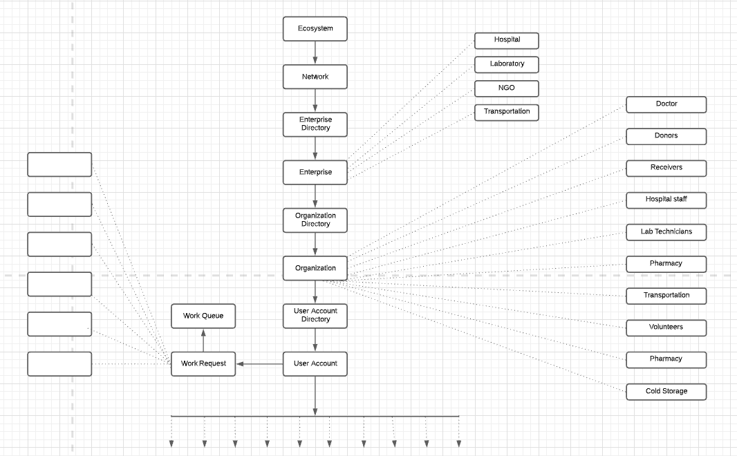

Slide 8
